Slide 1
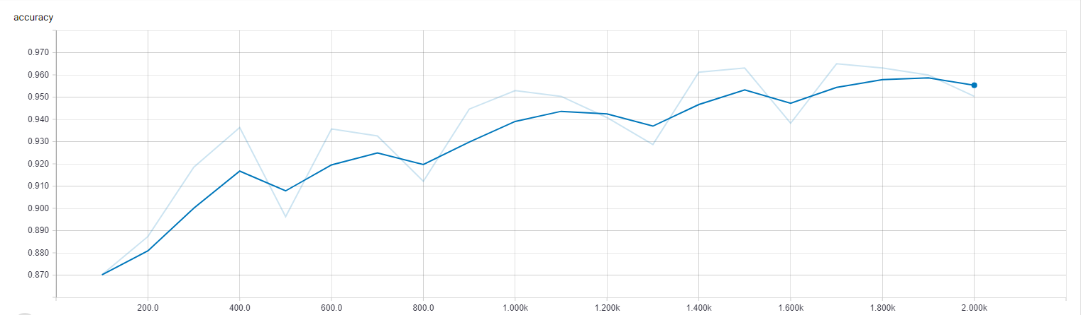
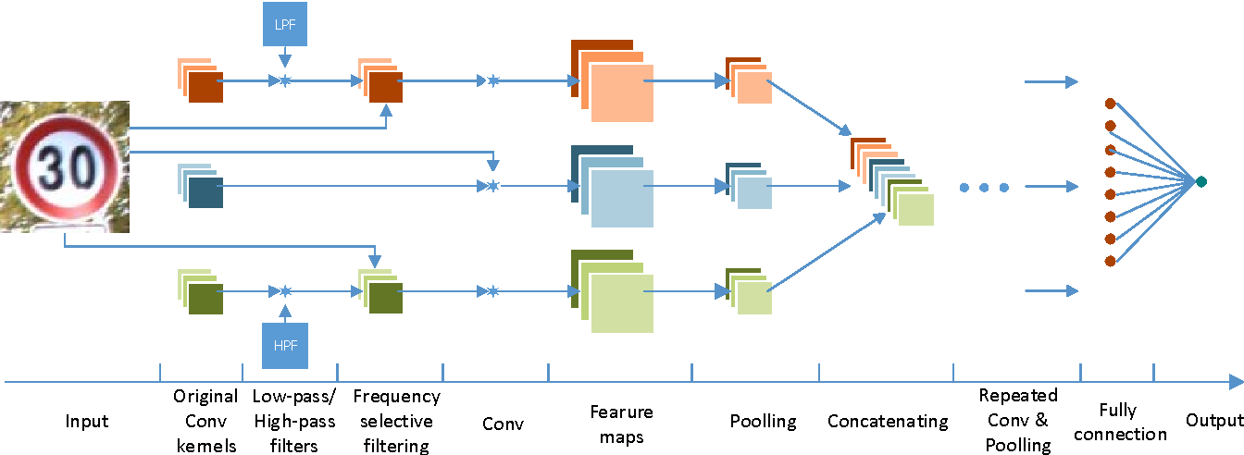
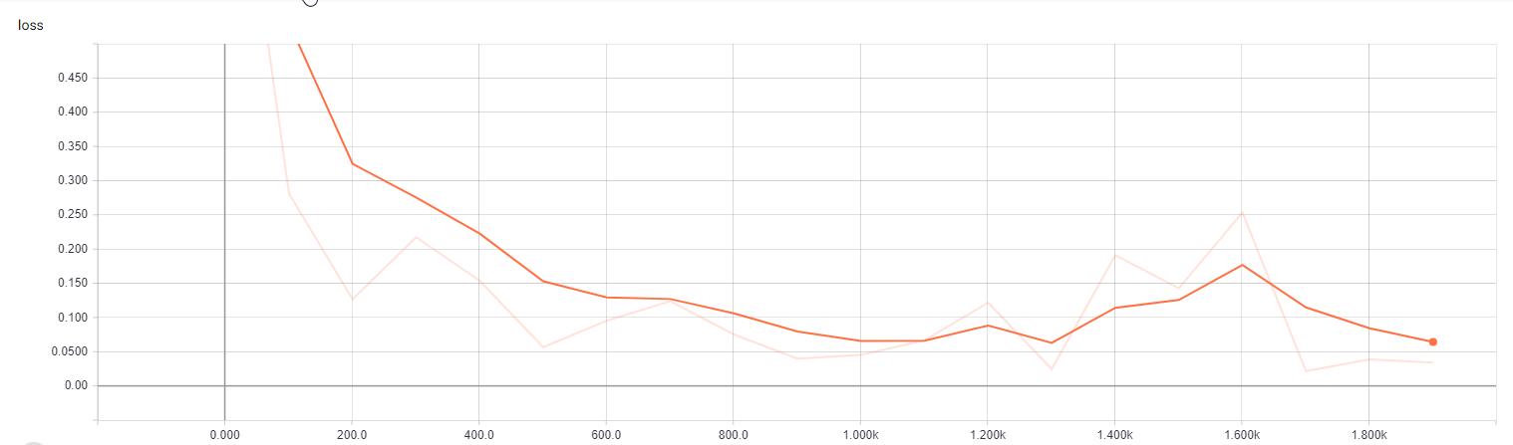



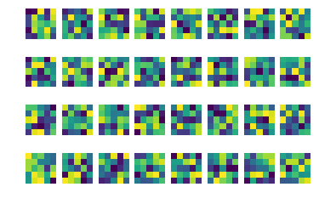


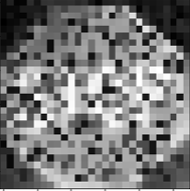

Autonomous Vehicle AI Analysis
Ankit Patel, Cristian Vives, Dr. Joseph Ernst, Mark Rogers, Di Jin
Hume Center Colloquium, April 18th 2018
Objective
Investigate how adversarial artificial intelligence prevention can help ensure the safety of future vehicles
Project Background
Using Python and TensorFlow to classify a large traffic sign dataset using a convolutional neural network (CNN)
Adversarial Phase: manipulate images within dataset to test vulnerabilities of machine learning and our CNN model and ensure accuracy
Creating the Neural Network
5 layers (Convolutional, Flattening, Pooling, Fully Connected)
Weights, biases, and filters to create the feature maps
Centered around TensorFlow and Estimator API
Key features of CNN
Dropout: Randomly ignoring neuron nodes during the training phase to prevent overfitting
Estimator API: Allows for high-level implementation of machine learning model
Training and Testing Neural Network
Images were split 80/20 to between training and testing
Adversarial Phase
Figure 3. Accuracy vs. Number of steps
Sample Images from the dataset
Number of different classes: 2
Data Processing
Over 7000 raw images varying in size
All images gray scaled to reduce channels
Images were upscaled by padding or downscaled
Used a Binary Classification System with respect to number of unique classes
Figure 1.“Under the Hood” structure of the CNN
Figure 4. Computed loss vs. Number of steps
Figure 2. Output of filters of the primary layer
Original
Result: Stop Sign
Blurred 70%
Result: Stop Sign
Salt and Pepper
Result: Not a Stop Sign
References
1. Andreas Møgelmose, Mohan M. Trivedi, and Thomas B. Moeslund, "Vision based Traffic Sign Detection and Analysis for Intelligent Driver Assistance Systems: Perspectives and Survey," IEEE Transactions on Intelligent Transportation Systems, 2012.
Notes:
Your page is set to be enlarged 200% so do not change the page size to fit another poster size.

